Slide 1
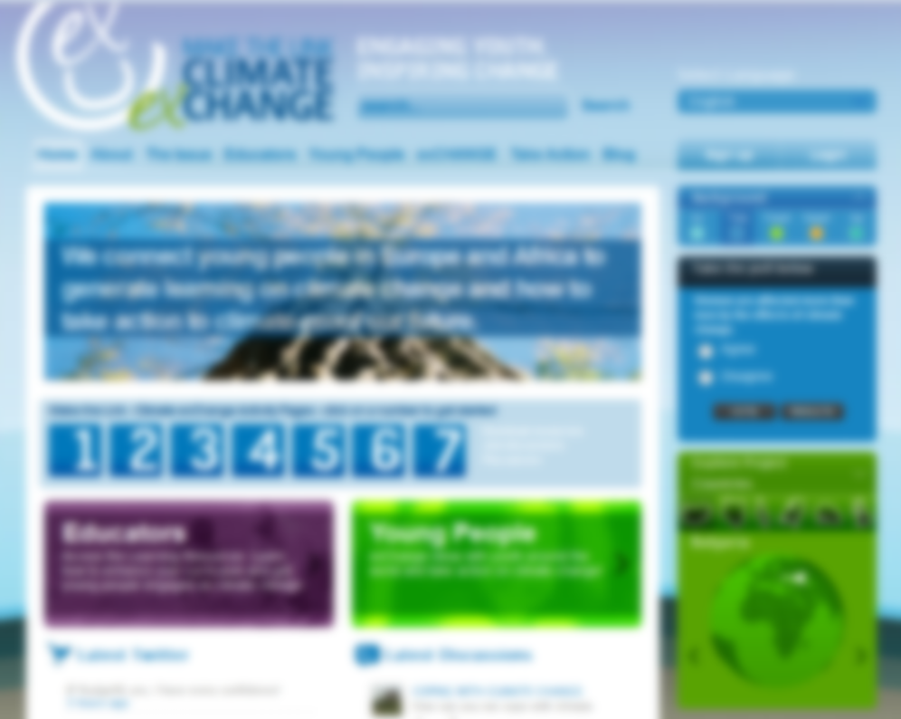
Connecting young people through climate change
www.mtl-cec.org

Slide 2
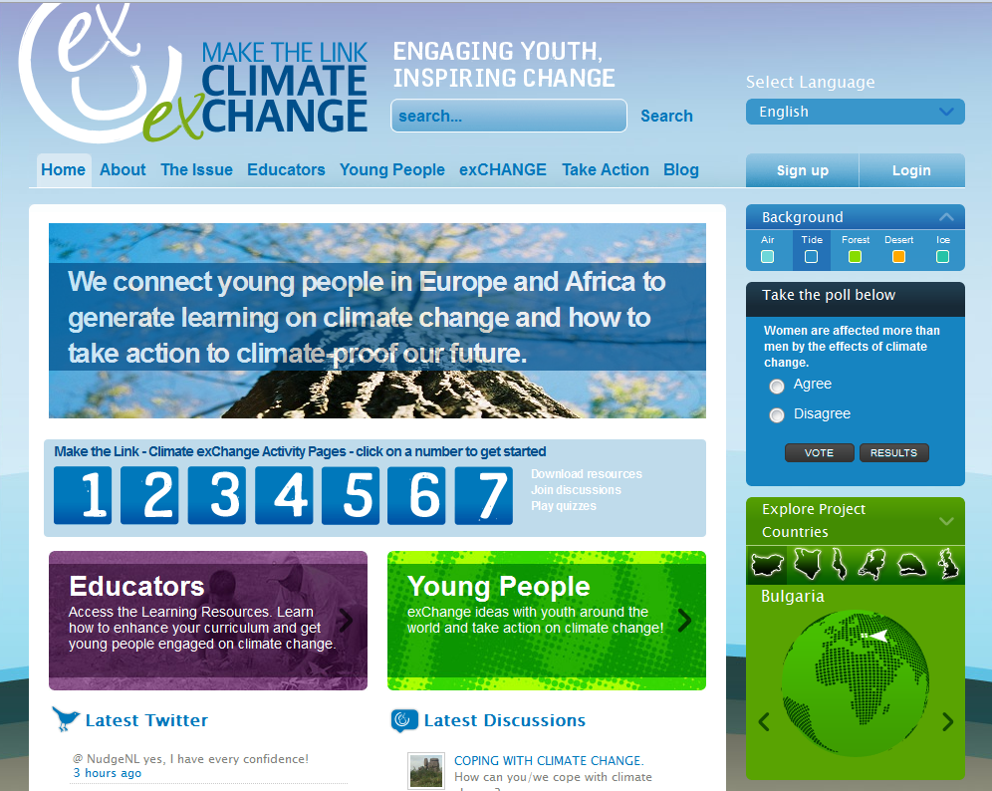

Slide 3
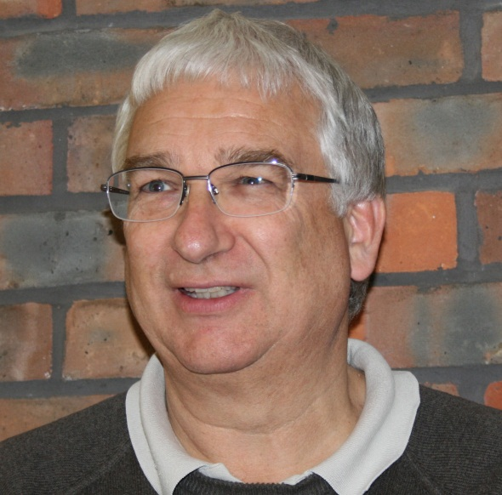
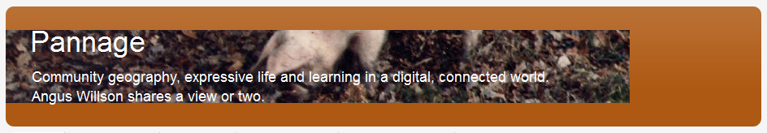
angus.willson@pannage.com
www.pannage.com
www.pannage.blogspot.com
@AngusWillson

Slide 4

Connecting young people through climate change
Engage with injustices of climate change
Connect with other students
Relate to sustainability, poverty, development and justice

Slide 5
How is this project different?
• Innovative method of linking 11 – 19 year olds from the UK, the Netherlands, Bulgaria, Senegal, Kenya and Malawi
• Similar teaching units adapted for each country
• Students exchange findings and engage in debate on a multi language interactive web platform
• Teachers and students can access learning resources on web platform
• Students encouraged to act at individual, community, national and international levels
• Gives young people opportunity to be at the centre of climate change debate.

Slide 6

www.mtl-cec.org

Slide 7
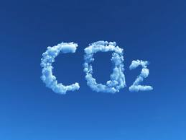
Why ‘youth debate’?
Participation

Slide 8

Why climate change?
Knowledge
Interdependence

Slide 9
Local implications of climate change
Aims of this unit:
To explore how climate change affects people’s behaviour, and to find out what individuals can do locally to reduce the impact of climate change and adapt to the change it causes.

Slide 10
Learning Outcomes:
• Students learn more about the impacts of climate change
in different localities around the world, and what it means
for people’s livelihoods now and in the future.
• Students understand that adults and young people all
around the world are taking action locally to reduce and
adapt to the implications of climate change, and learn
about inspiring examples of such action.
• Students begin to explore what the personal implications
are for them, and what actions they can take to make a
difference.

Slide 11
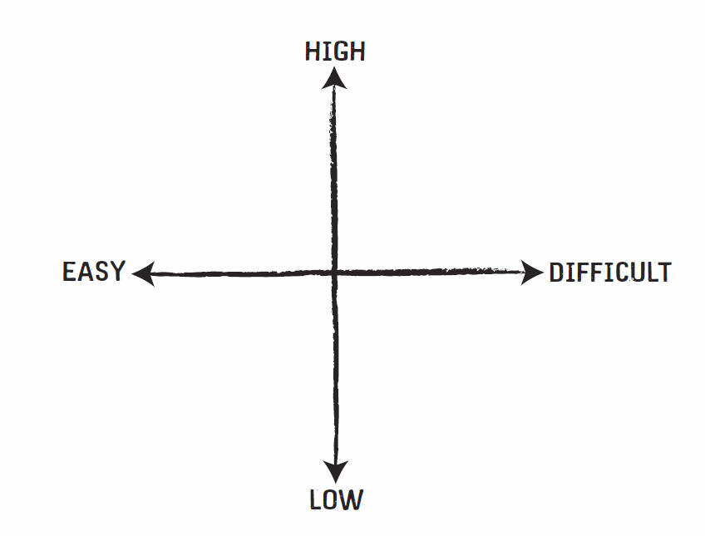
Impact of actions

Slide 12

Extension: two countries

Slide 13
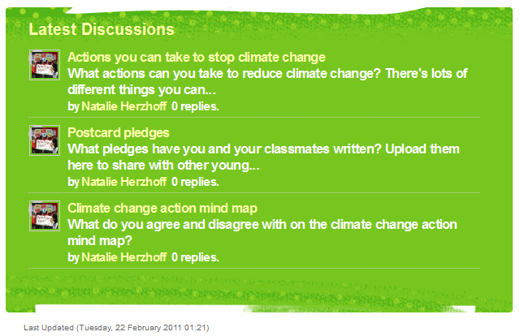
Notes:
http://www.mtl-cec.org/young-people/learning-resource-unit-5.html

Slide 14
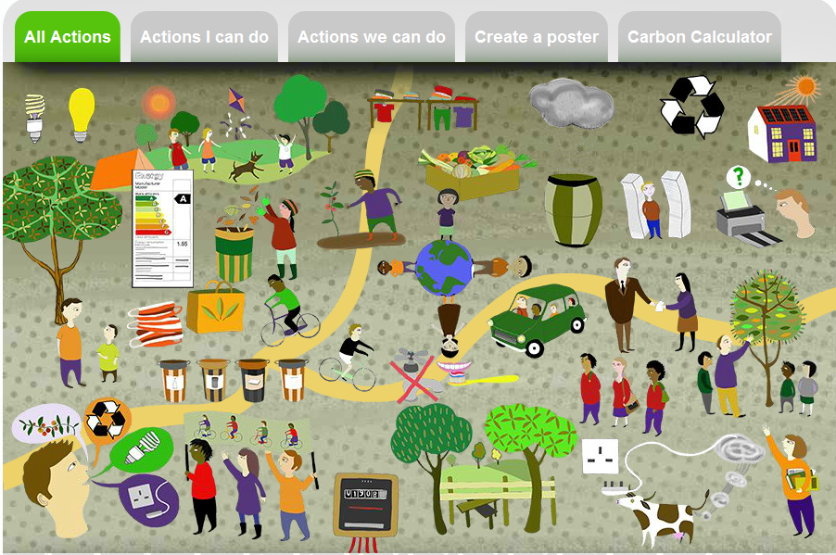
Notes:
http://www.mtl-cec.org/take-action/all-actions.html

Slide 15
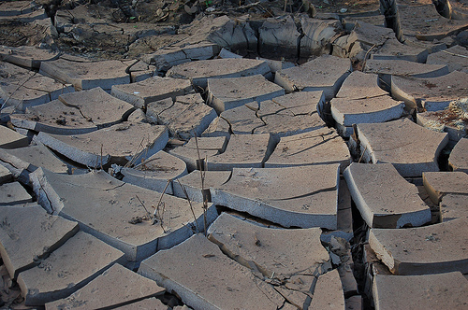
Online discussion
When we give pupil’s voice, it is appropriate to help them articulate their knowledge.
Where’s the geography?
Notes:
Dry Riverbed by Matt and Kim Rudge http://www.flickr.com/photos/mattandkim/94501076/

Slide 16
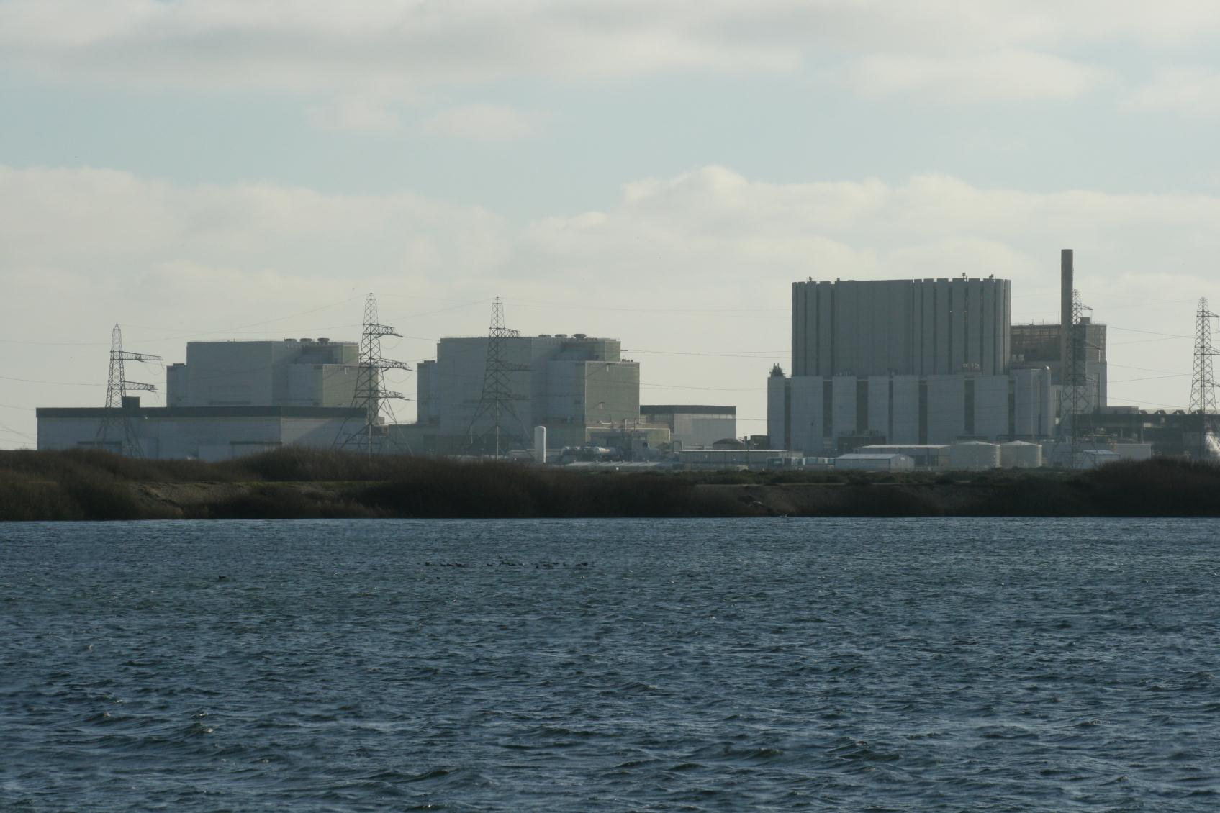
Online discussion
Are big, open-ended questions sufficient stimulus for informed debate?
How should it be structured, or semi-structured, to raise the quality of young people’s interaction?
Notes:
Photo: Angus Willson

Slide 17
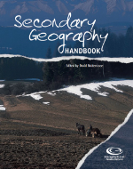
Creating a need to know / share
Stimulus to speculation
Stance
Choice
A motivating outcome
Margaret Roberts (2006)
How can I create a need to share
for my students?

Slide 18
Making sense of data
relate new information to existing knowledge
select data for themselves (awareness)
deal with conflicting data
apply geographical frameworks and concepts to knowledge
think for themselves about data (reconstruct)
reflect critically on what they have learnt
Margaret Roberts (2006)

Slide 19

Why here, in this school?
Why climate change?
Why ‘youth debate’?
Connecting young people through climate change
Engage with injustices of climate change
Connect with other students
Relate to sustainability, poverty, development and justice

Slide 20
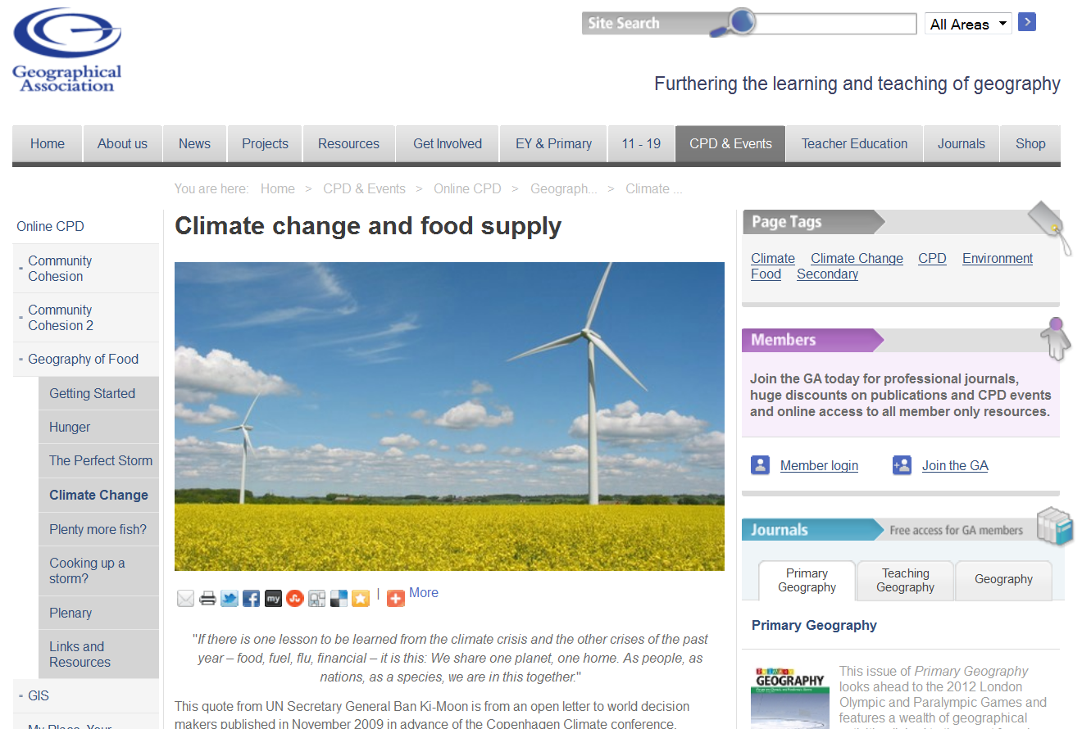
http://www.geography.org.uk/cpdevents/onlinecpd/geographyoffood/climatechange/

Slide 21
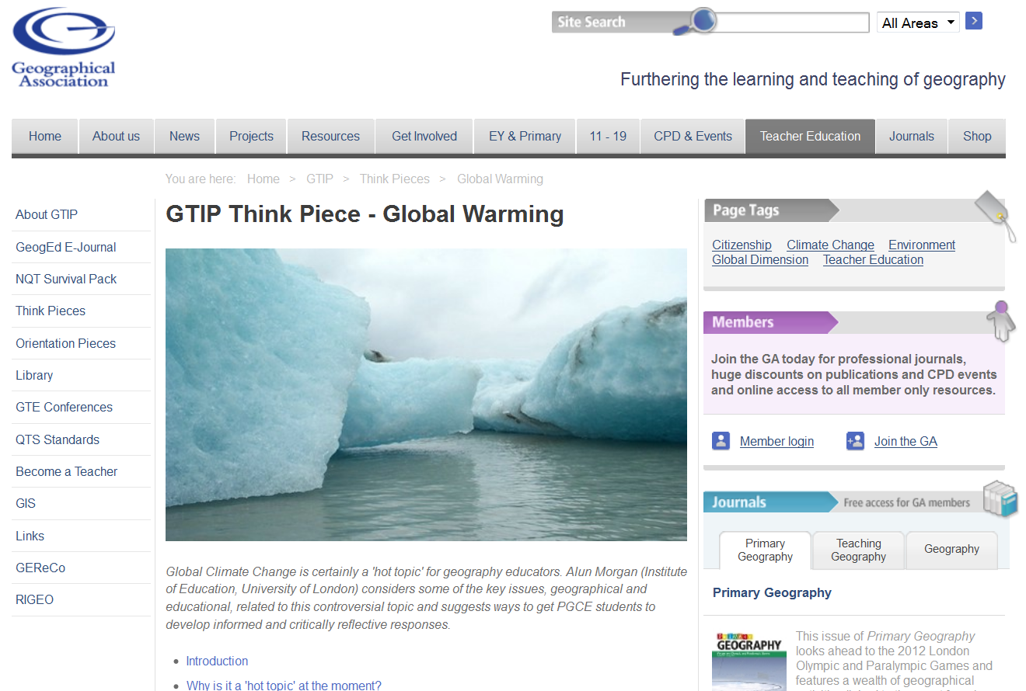
http://www.geography.org.uk/gtip/thinkpieces/globalwarming/#6095

Slide 22

A few more links
Tony Cassidy: Radical Geography http://www.radicalgeography.co.uk/Climatechange.html
Richard Allaway: Geography All the Way
http://www.geographyalltheway.com/myp/myp-alps/alps-climate-change.htm
GA: KS3 Geography Teachers' Toolkit: Changing My World What difference can we make to the climate? http://www.geography.org.uk/shop/shop_detail.asp?ID=571&section=3
RGS: Your climate, your life http://www.yourclimateyourlife.org.uk
DfE: Top Tips for Sustainability in Schools from http://www.education.gov.uk/aboutdfe/policiesandprocedures/a0070736/sd

Slide 23
angus.willson@pannage.com
www.pannage.com
www.pannage.blogspot.com
@AngusWillson

